Slide 1



Social Network Analysis Project
Kabanov A. G.

Slide 2
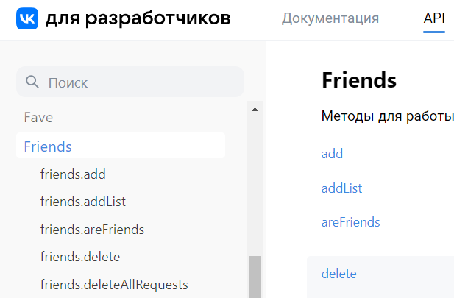
Data collection
VK API

Slide 3
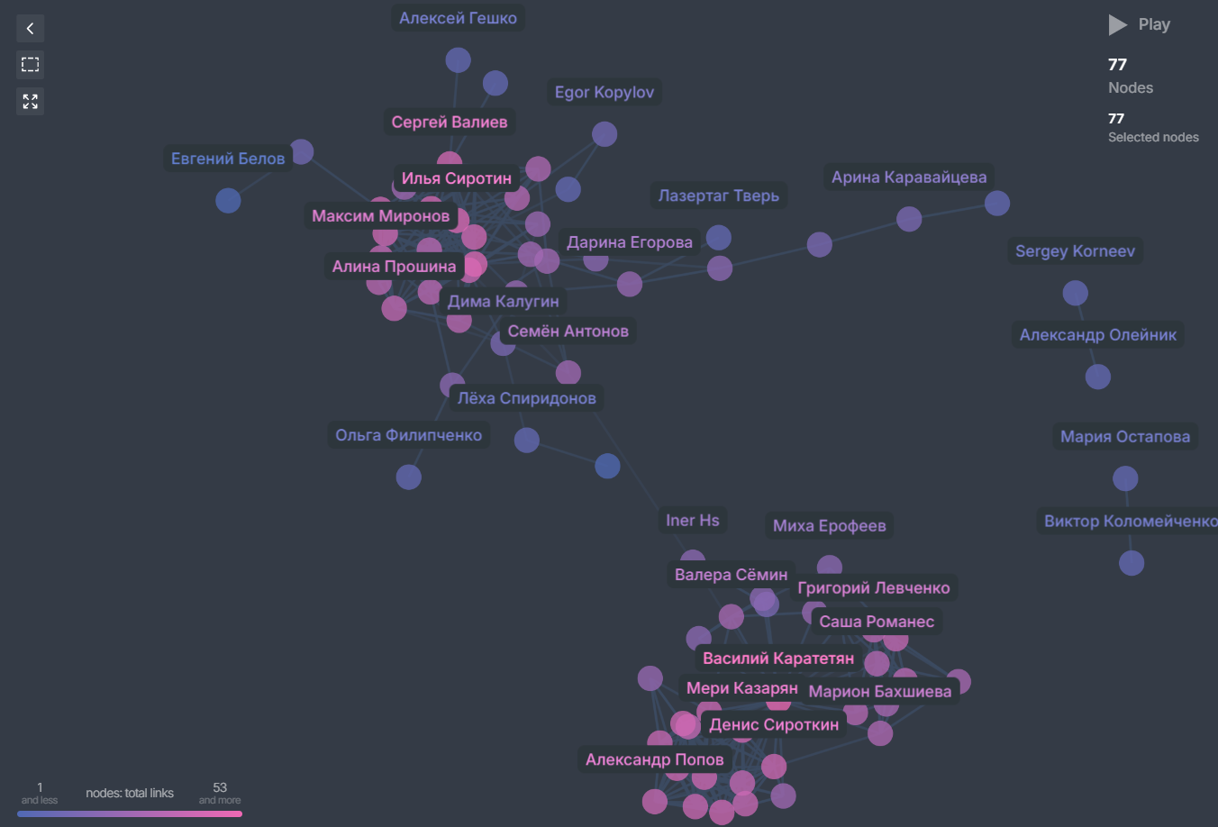

Summary
Total friends: 98 (4 are inactive)
DayZ
Show on graph: 77 (the rest don’t have connections)
Classmates
Largest connected component size - 73
Tver’
The graph is undirected, homogeneous, unweighted
The only connection is due to a random streamer
Relatives
Moscow

Slide 4
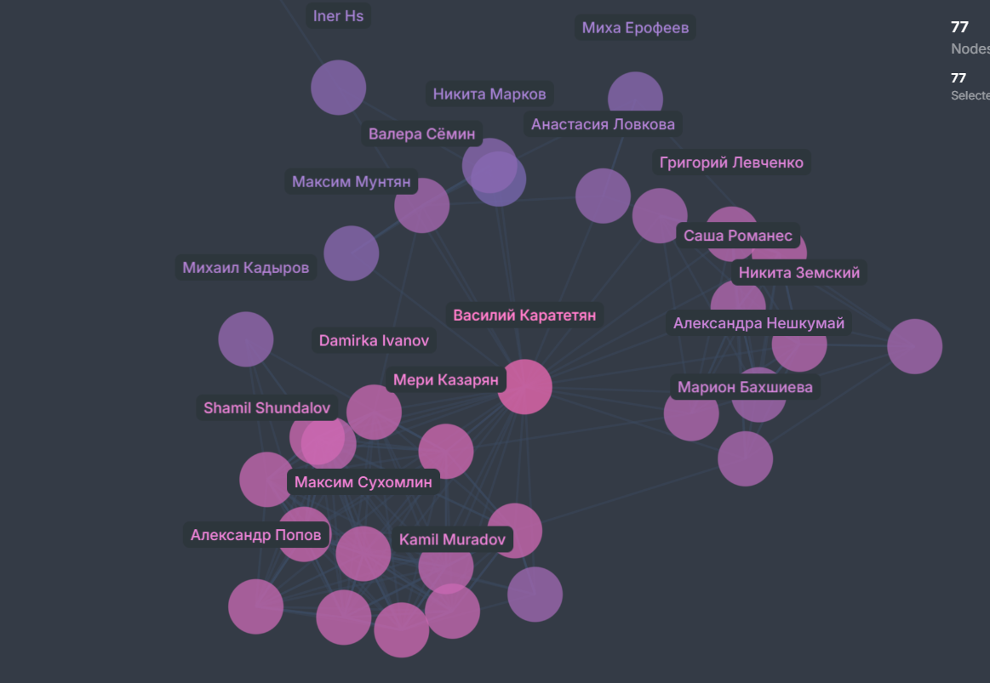
Summary
Cyberzone
The largest connected components statistics
Nodes – 73
Edges – 283
Diameter – 10
Radius – 5
2+ year
1 year

Slide 5

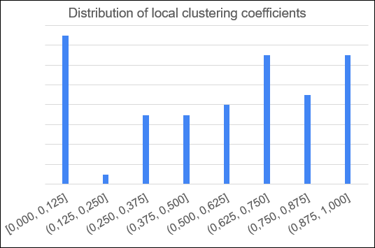
Summary
Average shortest path length: 4.06
Transitivity: 0.63
Average local clustering coefficient: 0.537

Slide 6

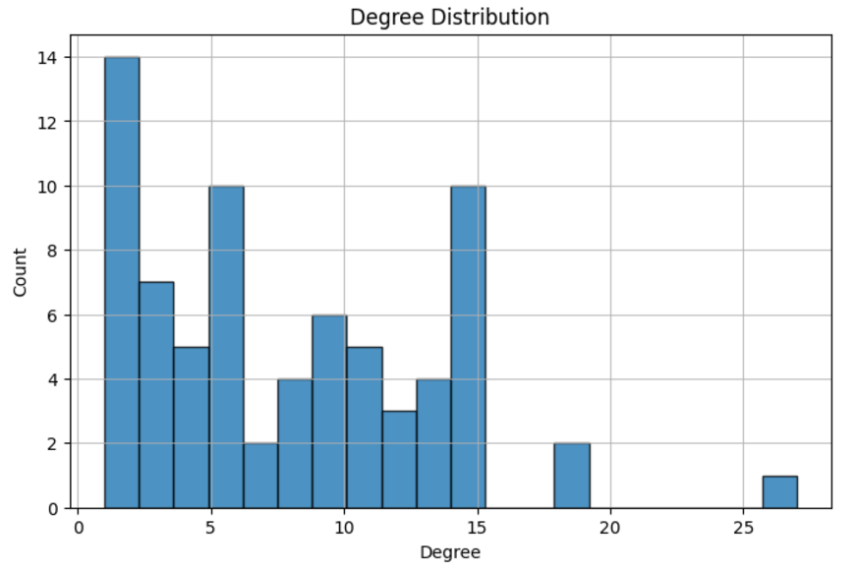
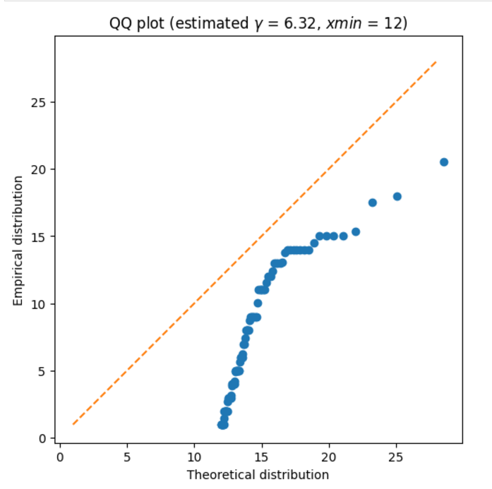
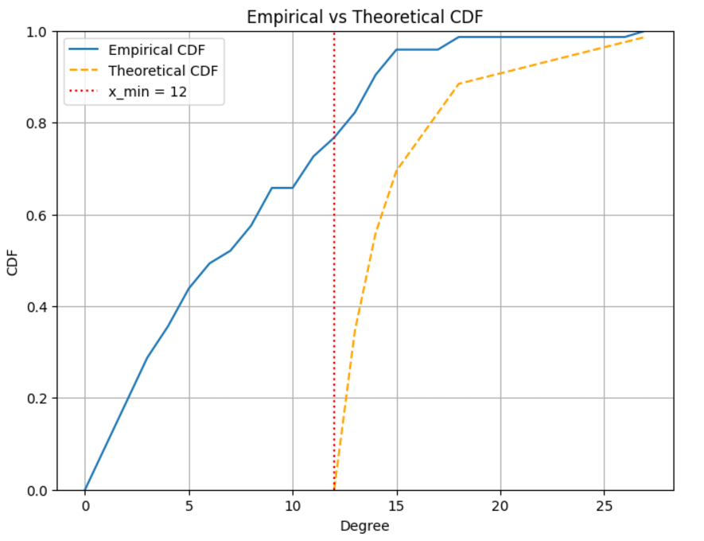
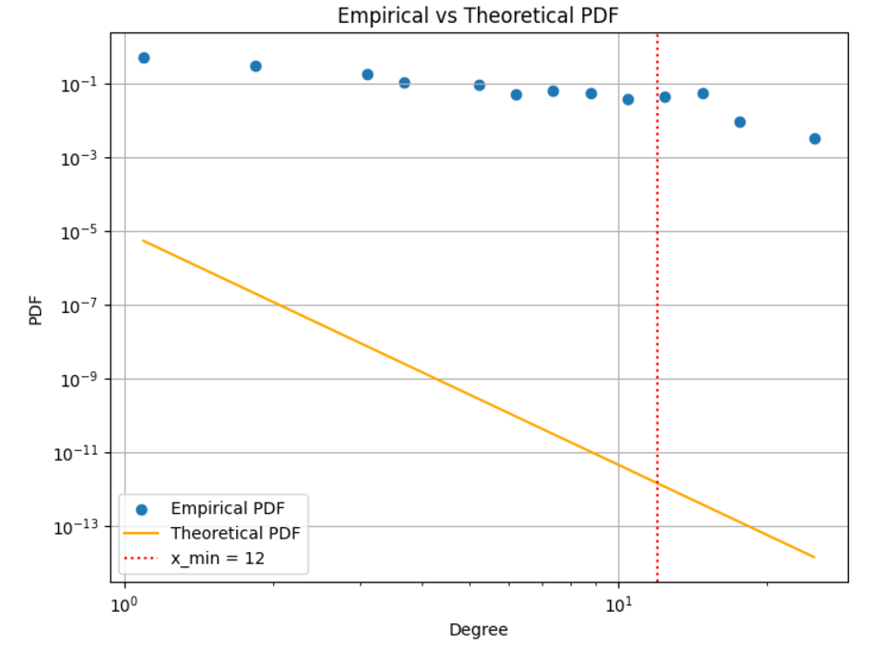
Power law

Slide 7
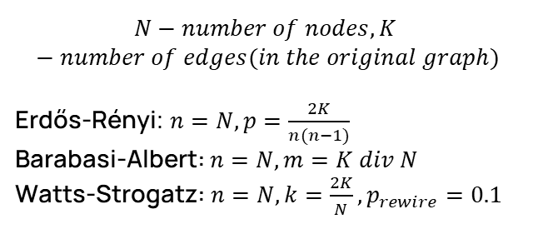
Random graphs
Metric | Original | ER | BA | WS
Radius | 5 | 3 | 3 | 5
Diameter | 10 | 4 | 4 | 8
Transitivity | 0.63 | 0.11 | 0.13 | 0.49
Avg local clustering coefficient | 0.54 | 0.10 | 0.17 | 0.53
Avg shortest path length | 4.06 | 2.3 | 2.49 | 3.86
$$N−number of nodes, K −number of edges(in the original graph)$$
Erdős-Rényi: $n=N, p=\frac{2K}{n(n−1)}$
Barabasi-Albert: $n=N, m=K div N$
Watts-Strogatz: $n=N, k=\frac{2K}{N}, p_{rewire}=0.1$

Slide 8
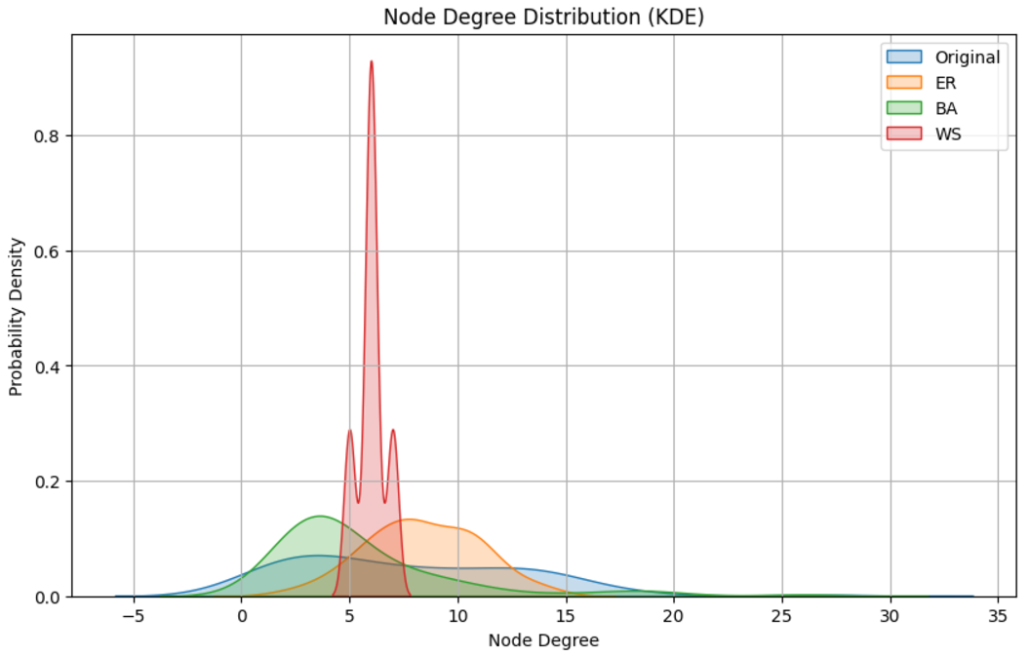
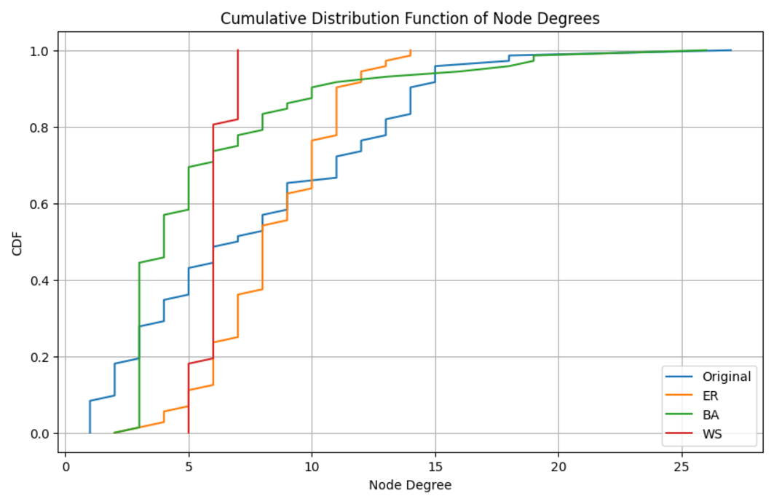
Random graphs

Slide 9
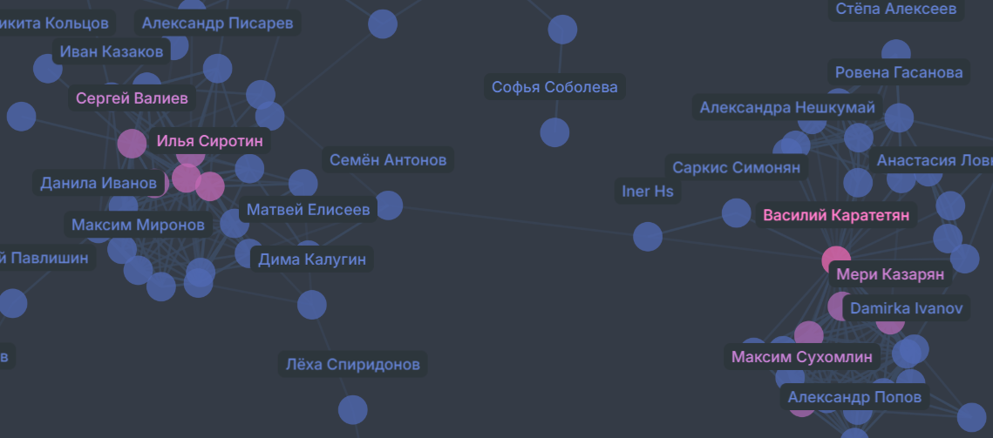
Degree centrality
Top 10 nodes are highlighted
Name | Degree centrality value
Василий Каратетян | 0.375
Илья Сиротин | 0.250
Аня Мгебришвили | 0.250
Дарья Иутина | 0.208
Артем Якуба | 0.208
Мери Казарян | 0.208

Slide 10
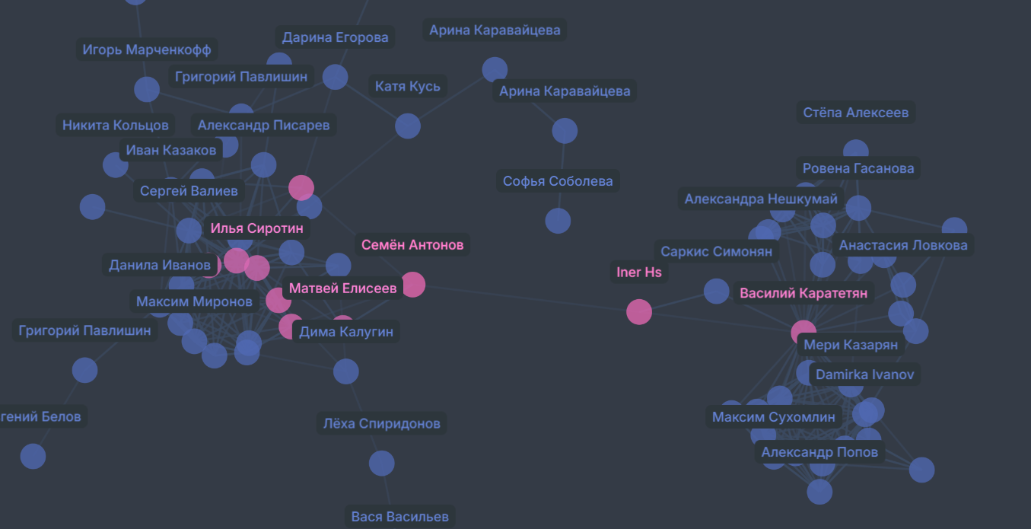
Closeness centrality
Top 10 nodes are highlighted
Name | Closeness centrality value
Семён Антонов | 0.353
Iner Hs | 0.338
Эльвин Гасанов | 0.327
Горислав Егоров | 0.323
Denis Antonov | 0.320
Василий Каратетян | 0.320

Slide 11
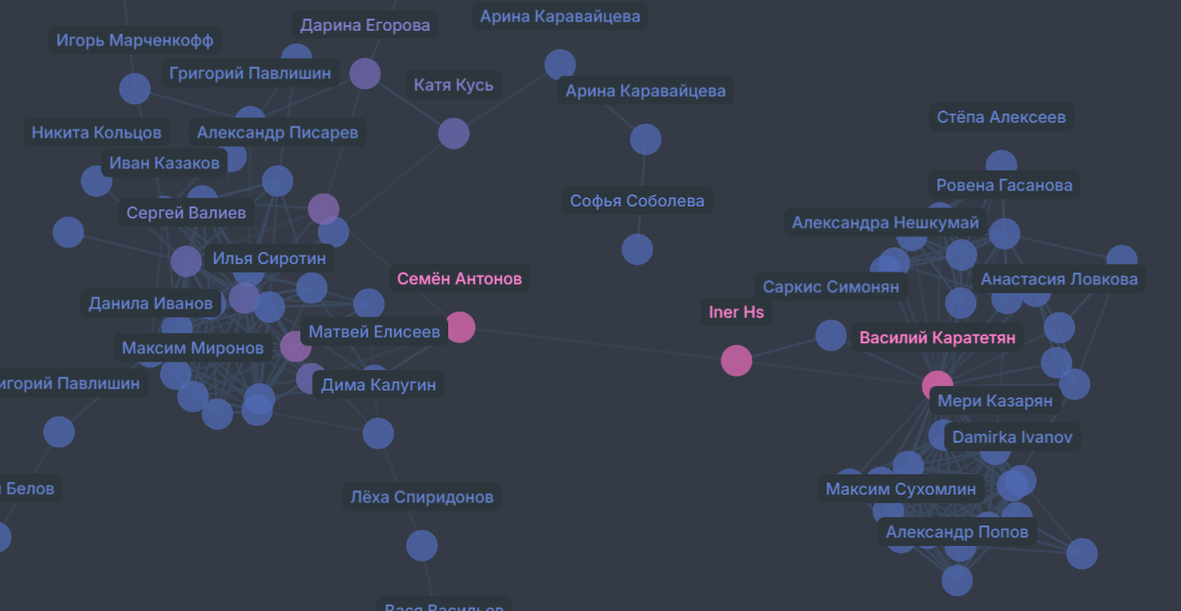
Betweenness centrality
Top 10 nodes are highlighted
Name | Betweenness centrality value
Василий Каратетян | 0.566
Семён Антонов | 0.504
Iner Hs | 0.497
Эльвин Гасанов | 0.221
Горислав Егоров | 0.162
Дарина Егорова | 0.099

Slide 12
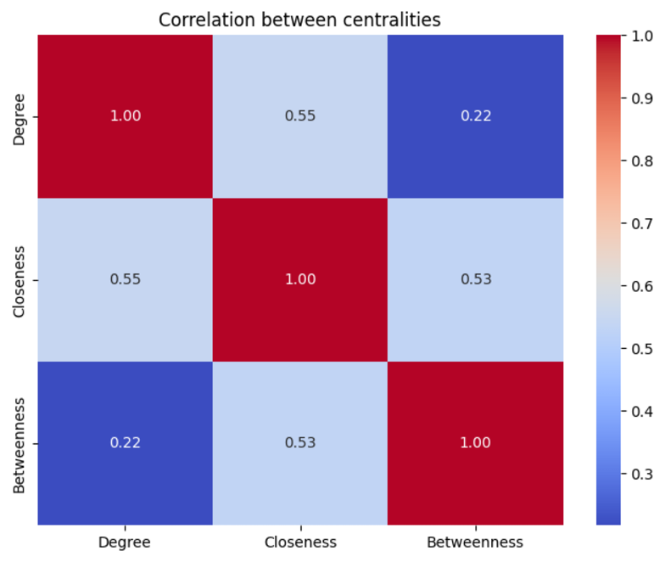
Correlation between centralities

Slide 13
Assortativity

Slide 14
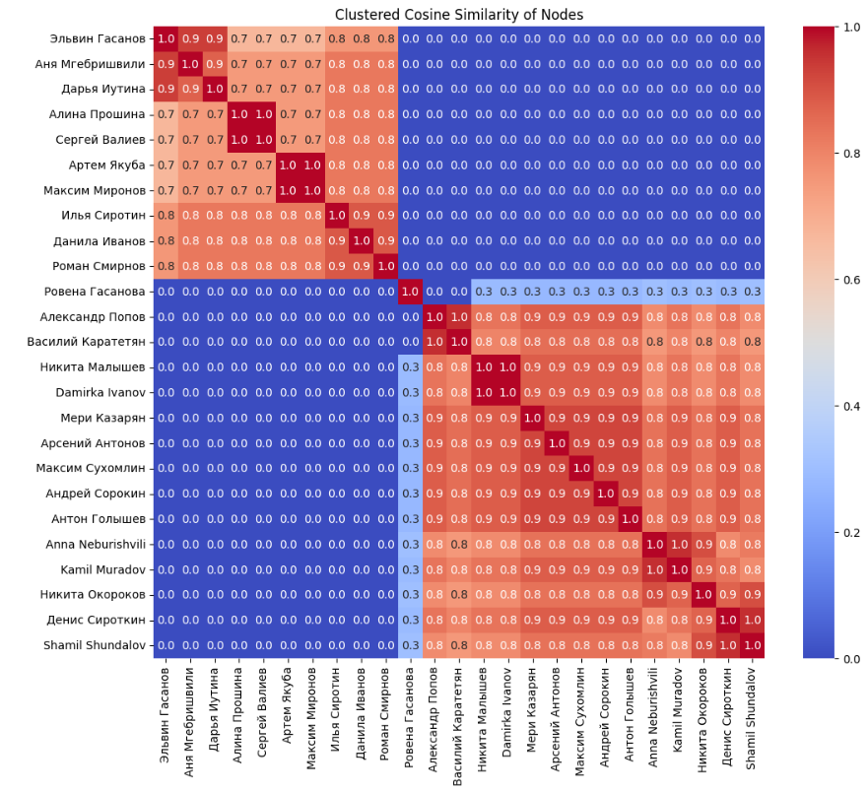
Node similarity
Only nodes with degree > 10 are left
Cosine similarity on adjacency matrix
Hierarchical clustering

Slide 15
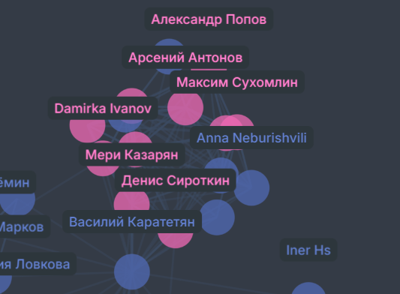
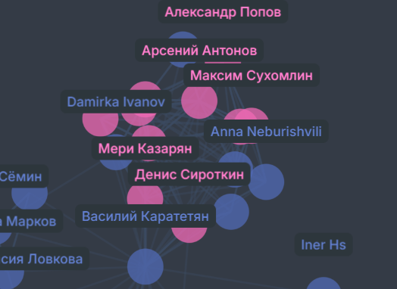
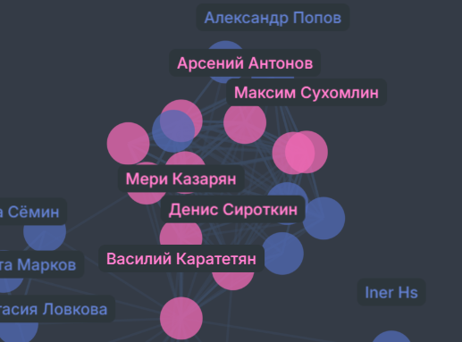
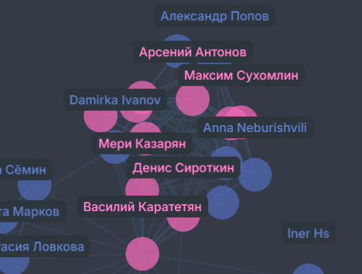
Largest cliques
4 similar largest cliques with size = 10

Slide 16
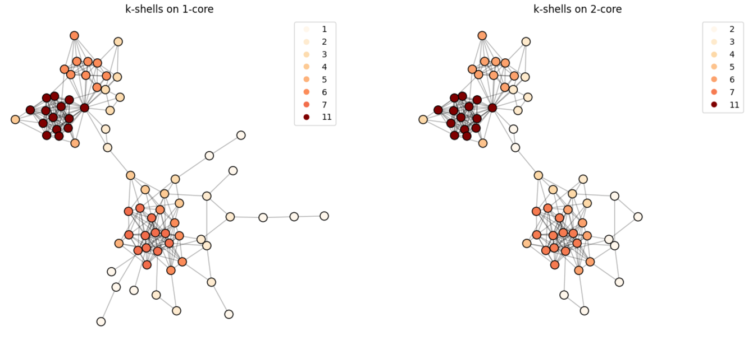
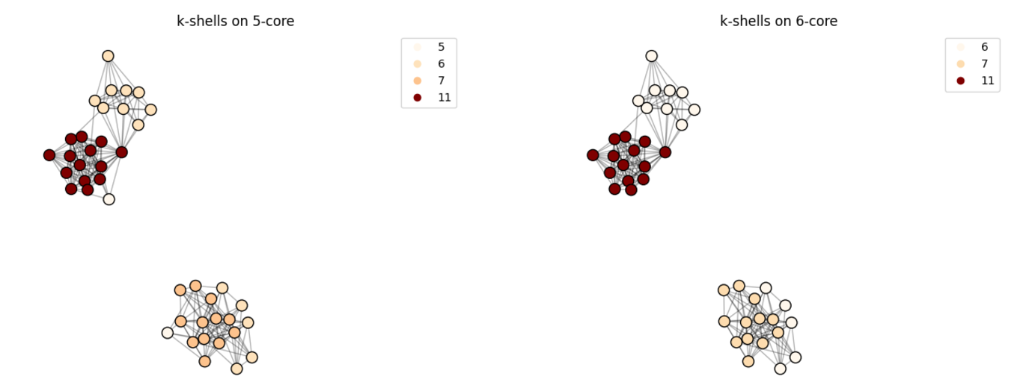
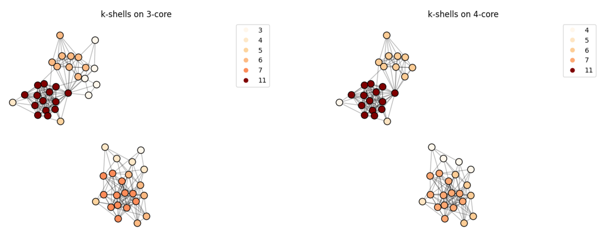
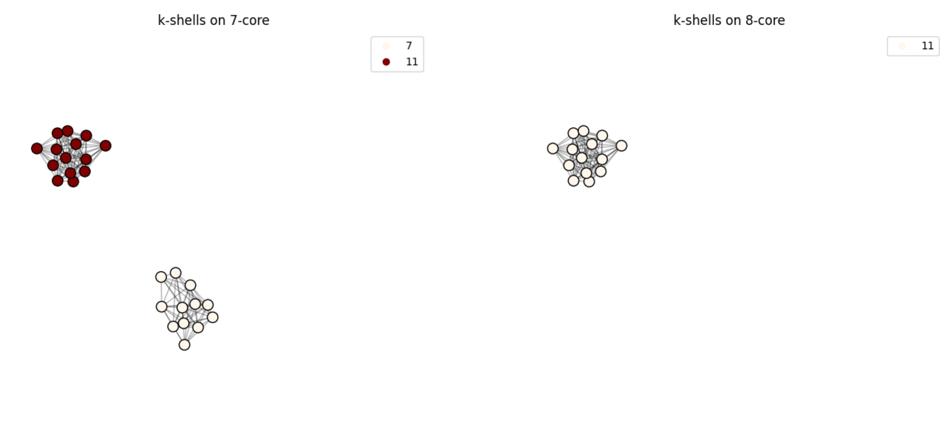
K-cores decomposition

Slide 17
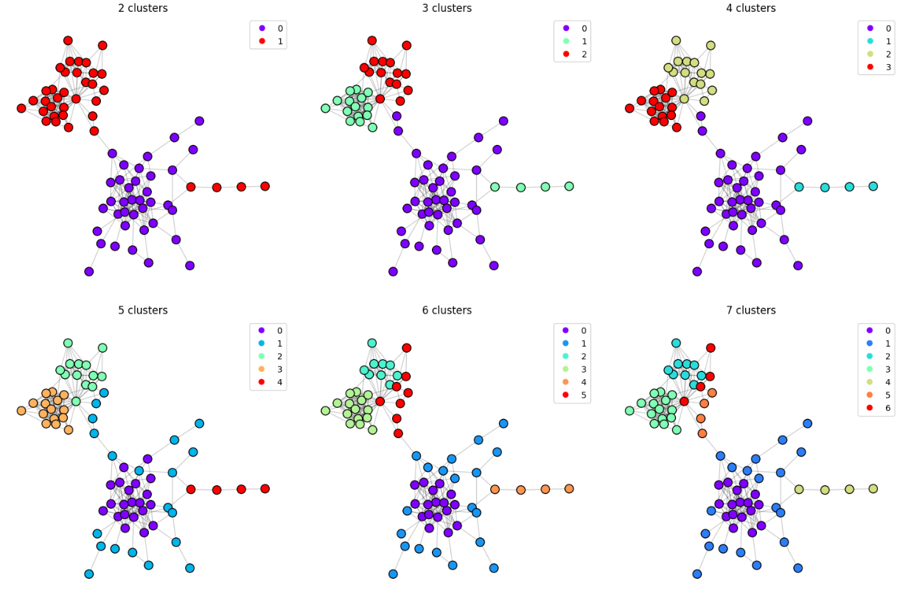
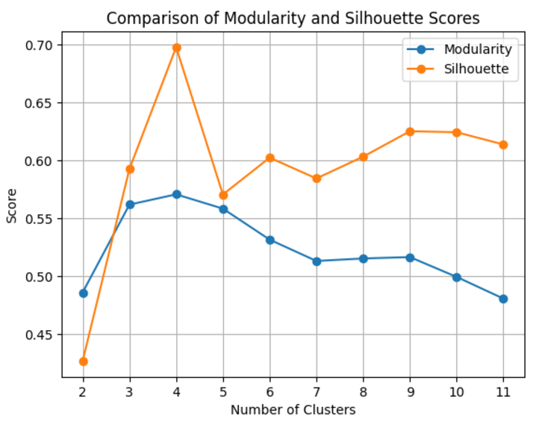
Laplacian eigenmaps + K-means

Slide 18
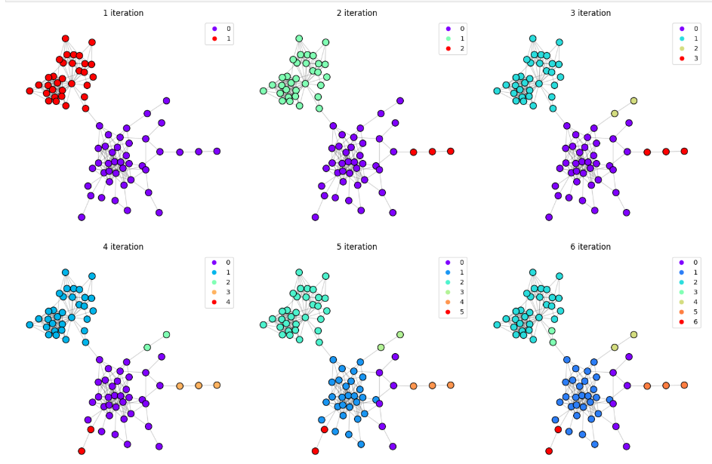
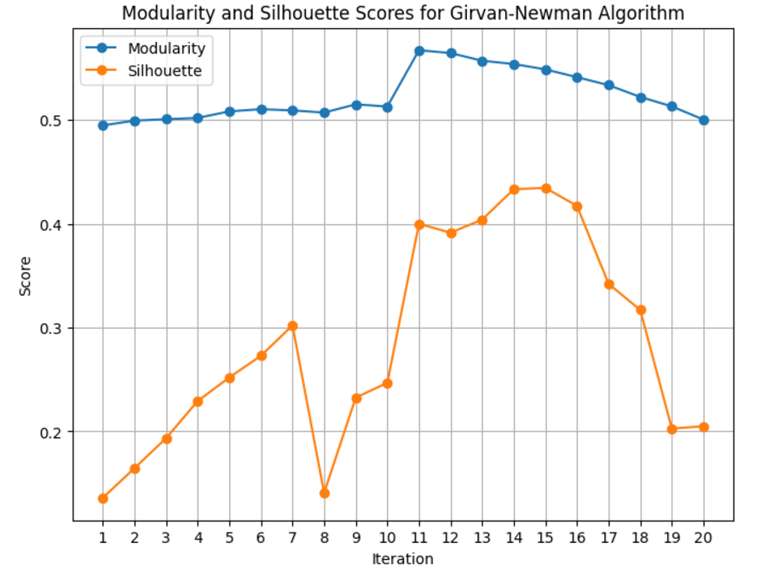
Girvan-Newman

Slide 19
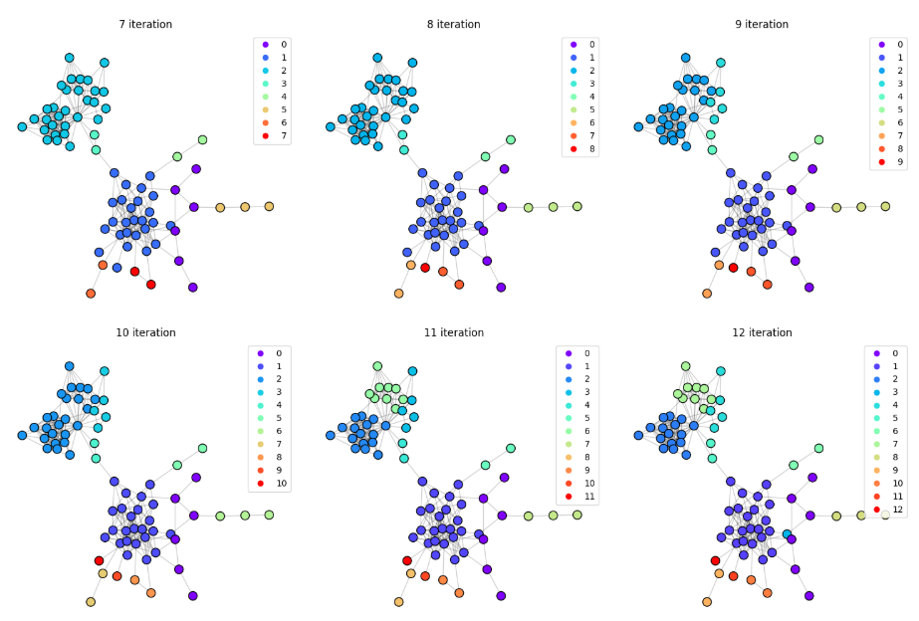
Girvan-Newman

Slide 20
The End. Thank you!

